Slide 1
Support, Opportunity & Service
Circles (SOS)
A Neighborhood Organizing Tool
Bob Van Oosterhout
bobvanoost@gmail.com

Slide 2
Organization
Two Options for Neighbor Circles (3-6 members each)
  Daily Contact Circles or Meeting Only Circles
    Each member makes brief contact with one other each day
    Meet 1-2x monthly to identify needs, interests, opportunities
Organizing Circles sets up, updates and monitors Neighborhood, Support, Opportunity, & Service Circles
SOS Circles research, coordinate, and develop community resources and opportunities (free & for pay) and member services (free or pay)
Coordinating Circle makes decisions & oversees overall operations
Advisory Circle provides other perspectives and options for the Coordinating Circle
Everyone agrees to actively participate in at least 2 Circles

Slide 3
Characteristics of IT Support System
Intuitive and User Friendly
Maximize use of checklists with capacity to occasionally add and reorganize categories
Option for large print for visually impaired
Reports forwarded to appropriate circles
Prioritize aspects that are useful in Gather
App & website that lists available Support, Opportunities and Member Services available

Slide 4
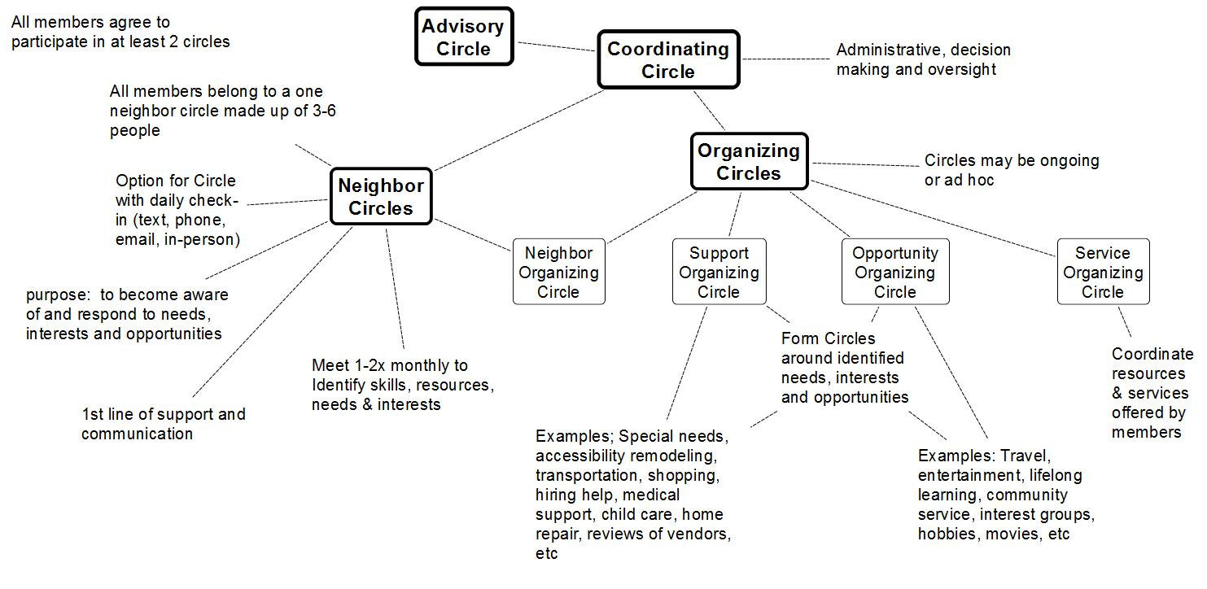
Overall Structure & Functions

Slide 5
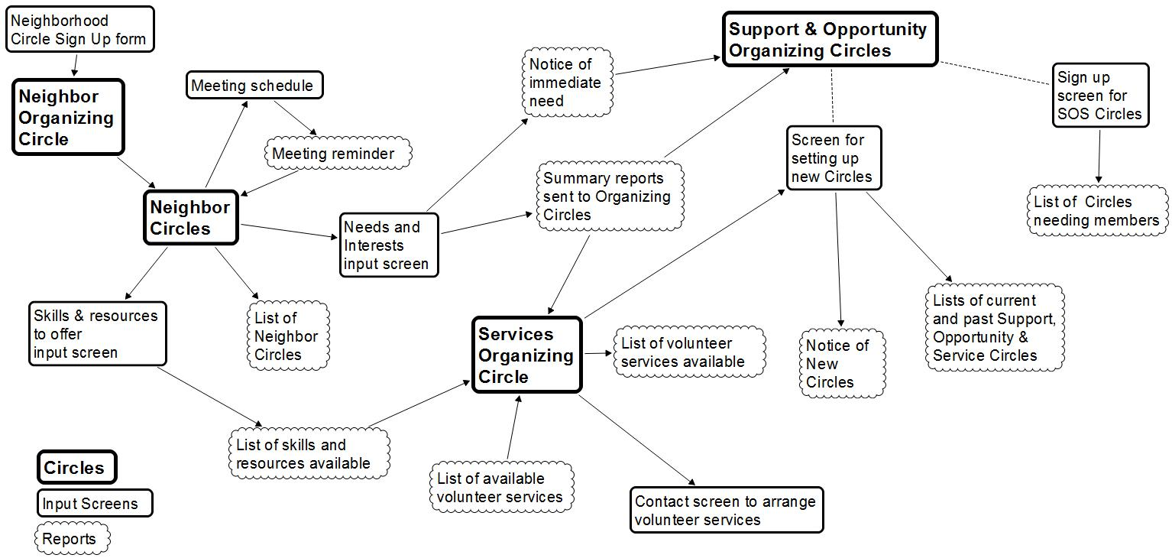
Overview of Screens and Reports

Slide 6
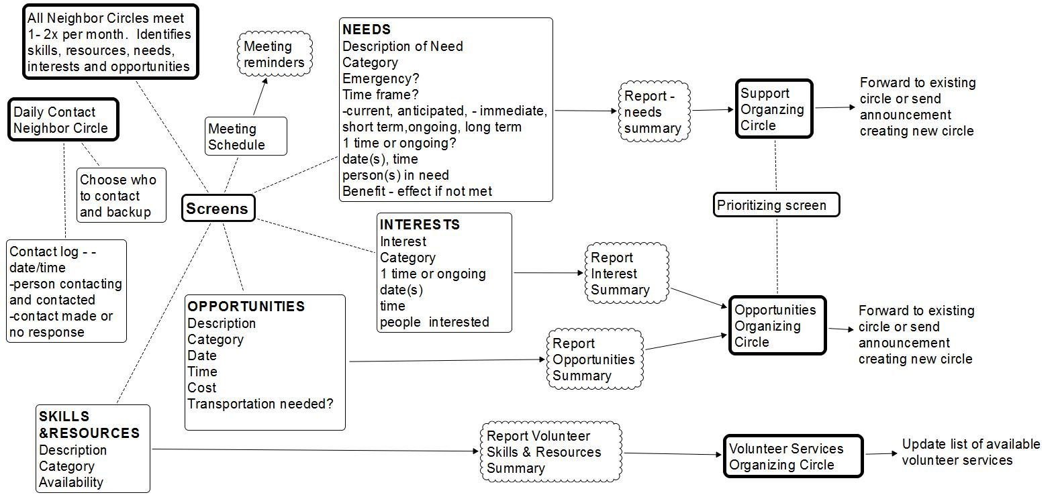
Input Screens and Reports for Neighborhood Circles

Slide 7
Input Screens and Reports for Organizing Circles

Slide 8
Structure for Summary of Resources, Member Services, & Opportunity Pages

Slide 9
Anticipated Initial Needs for Aging in Place

Slide 10
Values

Slide 11
Operating Principals

Slide 12
Priorities

Slide 13
Next Steps
Emphasize SOS to support Aging in Place
Apply for 501c3?
Join Village Network?
Identify most immediate needs

