Slide 1
Media Literacy: Helping Students Discover “What is True?”
Center for Teaching Excellence
Lansing Community College
November 7, 2017
Bob Van Oosterhout MA, LLP, LMSW
Bringtruthtofear.org
Bringtruthtofear@gmail.com

Slide 2
How to discover what is true
Restore Balance
http://bobvanoosterhout.com/id131.html
&
Ask Questions
www.bringtruthtofear.org

Slide 3
Topic:
Media Literacy and What is True
Ask as many questions as you can.
Do not stop to discuss, judge, or answer the questions.
Write down every question exactly as it is stated.
Change any statement into a question.
Adapted from Right Question Institute – Question Formulation Techniques http://rightquestion.org/

Slide 4
Evaluate Questions
Identify if questions are closed or open-ended
Rewrite some closed to open and open to closed
Label questions: Why? How? or What if?
Ask “Why did I come up with that question?”
Ask “What are the underlying assumptions of that question?”
Are there other questions that would be helpful to ask?

Slide 5
Prioritize questions
Choose 3 questions that…
you consider most important.
will help you understand the issues
will guide your reading
can be answered as you read/listen/explore
will help you solve problems related to media and truth

Slide 6
Next Steps
How can you find answers to these questions?
How can you know if the answers are true?
What other questions might be helpful?

Slide 7
Reflect
What did you learn from this process?
QUESTION FORMULATION TECHNIQUE
http://rightquestion.org

Slide 8
Definitions
Truth is a humble, comprehensive, and inclusive process of honest discovery of what is relevant and meaningful
True is what is accurate and consistent from various perspectives based on what we know up ‘til now.

Slide 9
Obstacles to Truth
Fear and Fear-Based Thinking
Stress, Tension, Pressure, Hurry
Certainty, Rigidity
Manipulation
Isolation
Ego

Slide 10
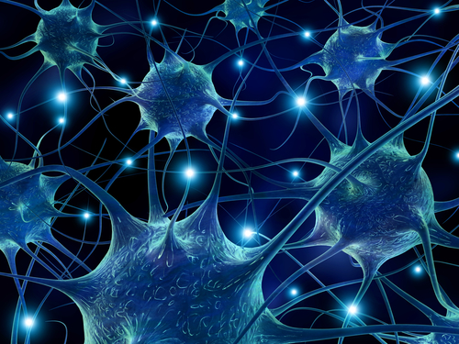
How the Brain Works
Thoughts, experiences, memories form links between brain cells (neurons)
At any given moment we are either creating new pathways or reinforcing old ones

Slide 11
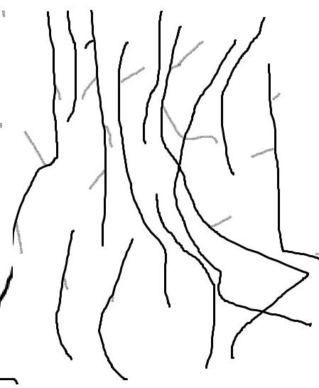
Brain Pathways formed by linear, fragmented learning
Brain Pathways formed by questions and reflection

Slide 12
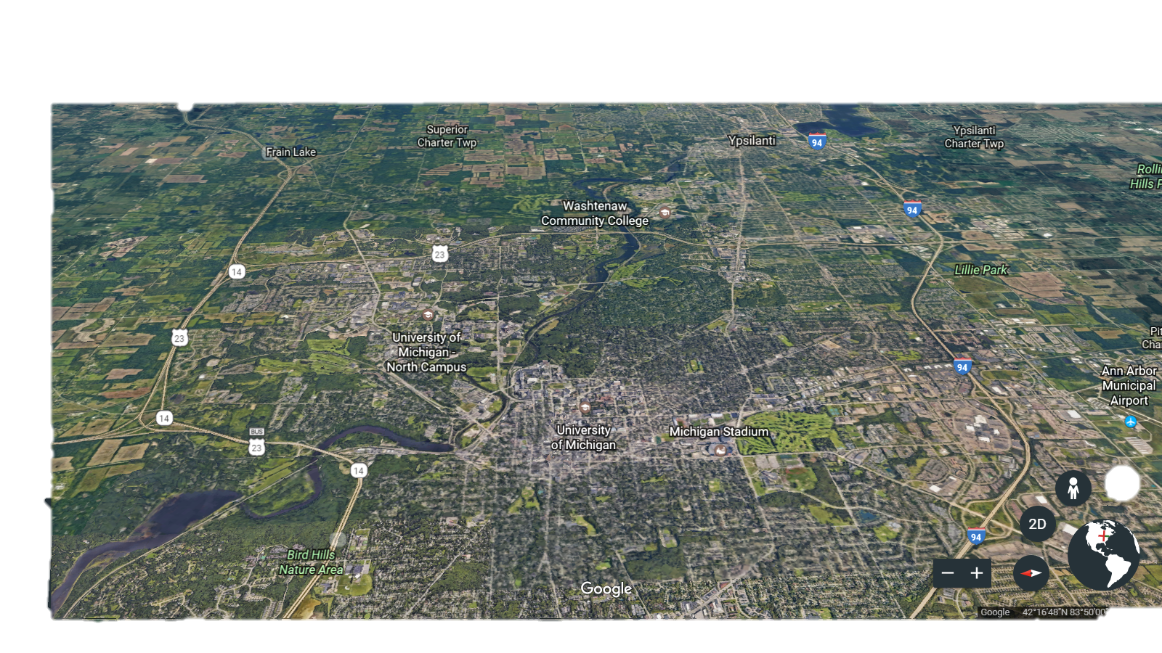
Formed Lots of New Pathways
Notes:
Creativity, intuition, zone

Slide 13
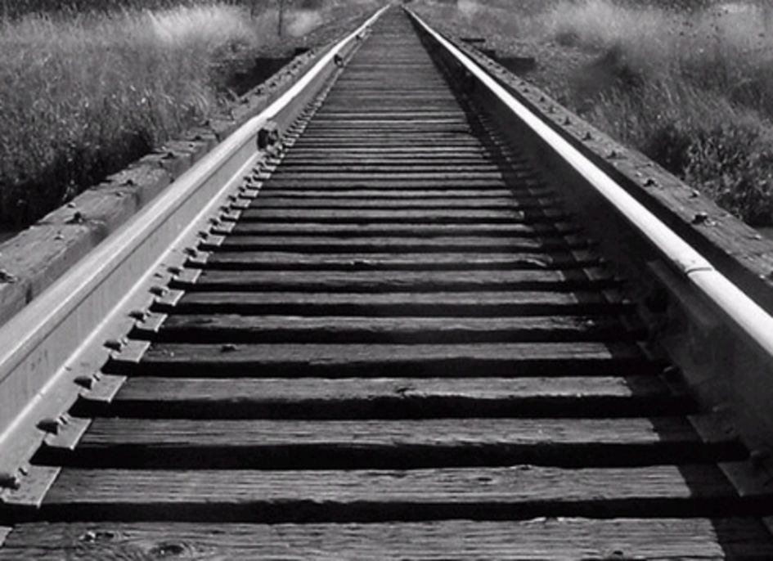
Reinforced Old Pathways

Slide 14
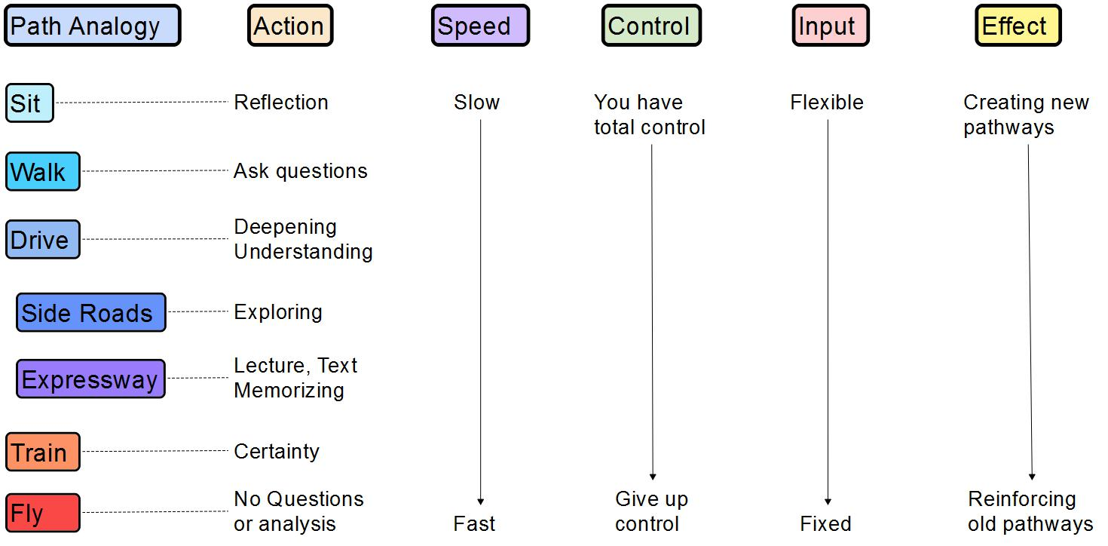
Ways We Form Pathways

Slide 15
Brain Pathways determine how we interpret and respond to reality

Slide 16
Did you Know?
Teens spend nearly 9 hours/day and children 8-12 spend 6 hours/day consuming media
The average American spends 8-11 hours per day looking at screens
“We have learned to connect with life in a way that leaves us disconnected”
-Tamarack Song
Notes:
Experience nature for contrast

Slide 17
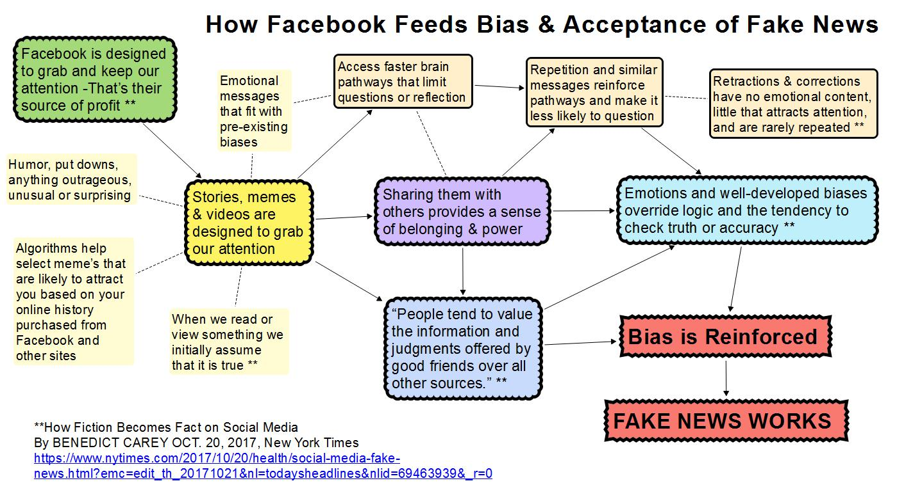
Notes:
Place to check Facebook stored information about you on resource list

Slide 18
Who will form or reinforce the pathways in your brain?
This can be an active, interactive or passive process
You Choose!

Slide 19
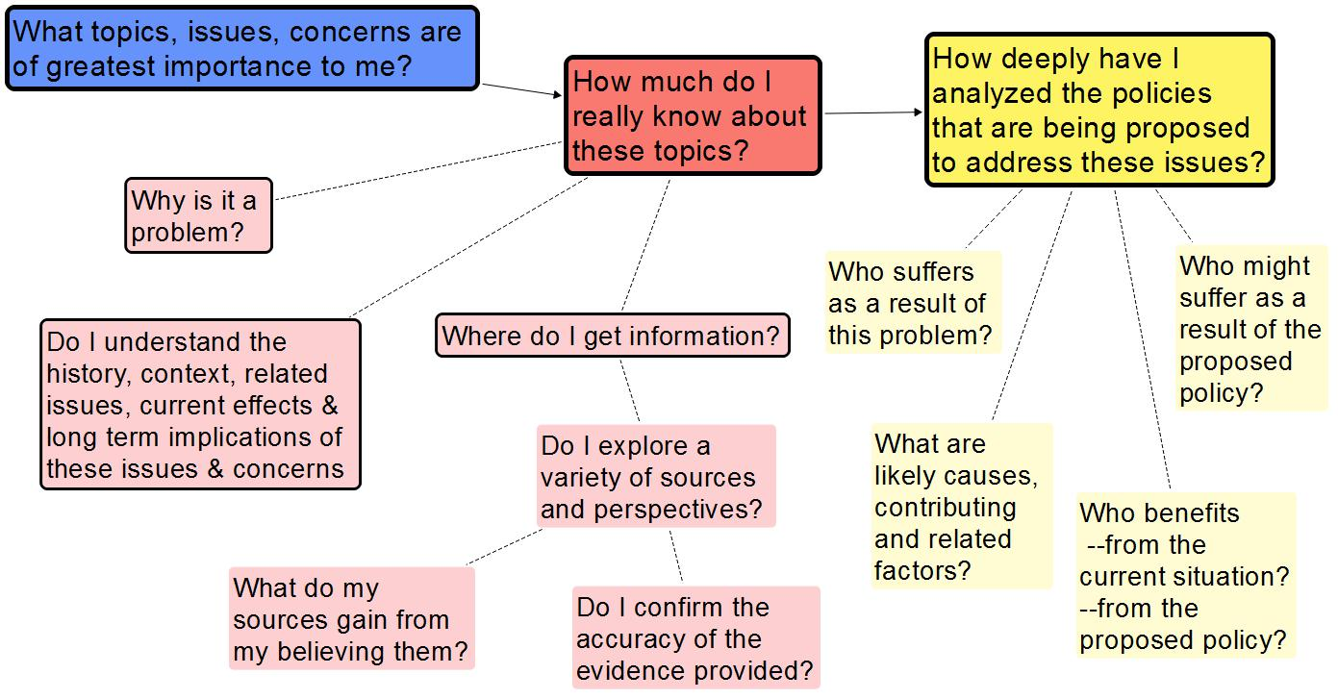
Questions to Ask Myself
Notes:
We need to open or minds to create pathways that bring us closer to truth

Slide 20
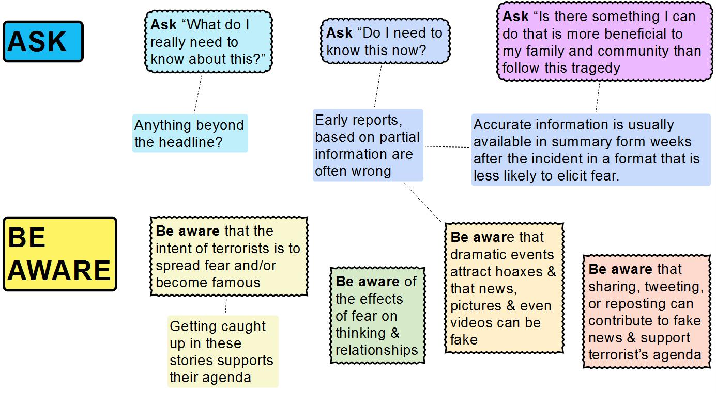
Responding to News of Tragedy or Terrorism

Slide 21
Choose Your News
What do I need to know?
Why do I need to know it?
How much do I need to know?
When do I need to know it?

Slide 22
The best first step is often to step back.

Slide 23
What is Media Literacy?
Media Literacy is a 21st century approach to education. It provides a framework to access, analyze, evaluate and create messages in a variety of forms – from print to video to the Internet.
Media literacy builds an understanding of the role of media in society as well as essential skills of inquiry and self-expression necessary for citizens of a democracy.
www.medialit.org

Slide 24
Purpose of Media Literacy
Media literacy is about helping students become competent, critical and literate in all media forms so that they control the interpretation of what they see or hear rather than letting the interpretation control them.
To become media literate is not to memorize facts or statistics about the media, but rather to learn to raise the right questions about what you are watching, reading or listening to.
www.medialit.org

Slide 25
Core Concepts of Media Literacy
All media messages are ‘constructed.’
Media messages are constructed using a creative language with its own rules.
Different people experience the same media message differently.
Media have embedded values and points of view.
Most media messages are constructed to gain profit and/or power.
www.medialit.org

Slide 26
Components of Truth
Vertical
  Assumptions, Evidence, Sources, Reasoning
Horizontal
  History, Context, Related Issues, Other Perspectives
Heart
  Is it divisive? - Does it isolate us or connect us?
  Does it bring us together or drive us apart

Slide 27
How to recognize Fake News & attempts to manipulate me
Ask
Is it divisive?

Slide 28
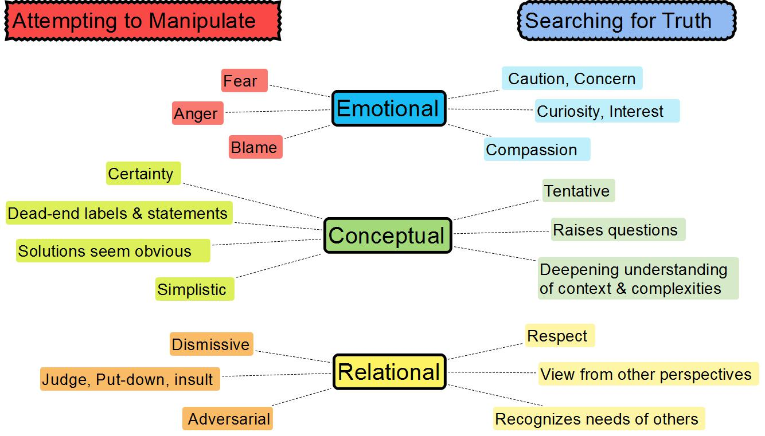

Slide 29
A Tool to Help Discern What is True
Meditation
Train your mind to recognize when it’s being pulled in a direction that is not helpful and redirect it to where you want to focus
https://www.youtube.com/watch?v=dxzZxltHuV0

Slide 30
Next Steps:
What can you do to promote Media Literacy and Respect for Truth?

