Slide 1
Elements of Perception
Frame
Creates boundaries for thought, understanding and experience
Filter
Present emotional state, mood, attitude
Determines receptivity, trust, openness, motivation
Focus
What we pay attention to
Determines importance

Slide 3
Filters shape and limit what you see and understand

Slide 4
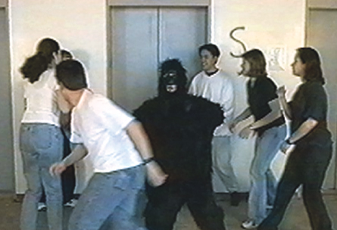

Slide 5
Frame, Filter, Focus What Works
Frame
Flexible, Expanding, Inclusive
Filter
Clear and Receptive
Focus
Adaptable Matches priorities
Fits needs of situation

Slide 7
Perception: What Works/ What Goes Wrong
Components of Clear Perception
Components of Restricted Perception
Compassion
Personal Responsibility
Humility
Hope
Defensiveness
Blame and/or Control
Self-Centeredness
Fear

